Slide 1
Introduction to MySQL
PHP & MySQL for Dynamic Web Sites

Slide 2
What You Will Learn
Naming Database Elements
Choosing Your Column Types
Accessing MySQL

Slide 3
Naming Database Elements
Names (@ identifiers) should be clear and meaningful
Only contain letters, numbers, and underscores (no spaces)
Can not be same as an existing keyword
Should be treated as case-sensitive

Slide 4
Example
Users table
Column name | Example
user_id | 1
first_name | Effy
last_name | Stonem
email | effy@skins.co.uk
registration_date | 1-1-2020

Slide 5
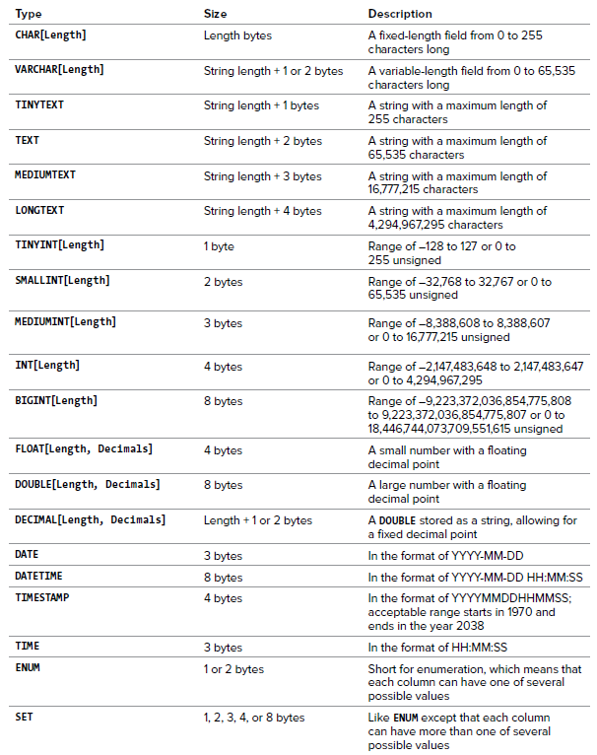
Choosing Your Column Types

Slide 6
Example
Column name | Type | SQL Type
user_id | number | int(11)
first_name | text | varchar (32)
last_name | text | varchar (32)
email | text | varchar (32)
registration_date | datetime | datetime

Slide 7
Char vs Varchar
Both can store string value
Example Storing Cat = 3 bytes
Char (10) = use 10 byte disk space Varchar(10) = use 3 byte disk space
If a string field will always be of a set length, use Char. Otherwise use Varchar.

Slide 8
Datetime vs TimeStamp
Both store date and time.
MySQL converts TIMESTAMP values from the current time zone to UTC for storage, and back from UTC to the current time zone for retrieval
if you want to serve your date and time data the same way regardless of timezones, you can use the DATETIME type. Otherwise, you can use TIMESTAMP and serve the data on a per-timezone basis.

Slide 9
Choosing Column Properties
Not Null and Null eg. email varchar(20) not null
Unsign (Will only store positive numbers) eg. user_id int(11) unsigned
Indexes are used to find rows with specific column values quickly.
Index (or key) doesn't enforce any restraints on your data so they are used only for looking up data more efficiently.
Both Unique and Primary keys cannot hold duplicates.
Unique key allows null values. Primary key doesn’t allow null values.
Fulltext: a more specialized form of indexing that allows full text search

Slide 10
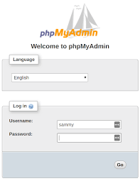
Accessing MySQL
MySQL Client (Command line)
PhpMyAdmin (GUI)

